Slide 1


Final Project report
Submitted by :
Syed Bilal Ali 4748
Omer Jabar 4768
Mesum Abbas 4736
Ahmed Belal 4598
Submitted to :
Shakeel Ahmed
the references:
https://github.com/aabbasmesum/Gym-Management-System

Slide 2

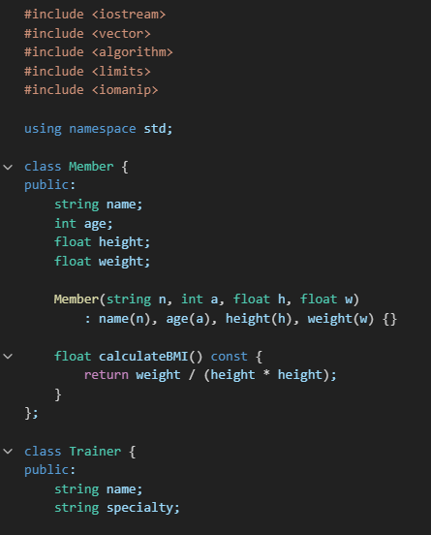
Source code:

Slide 3
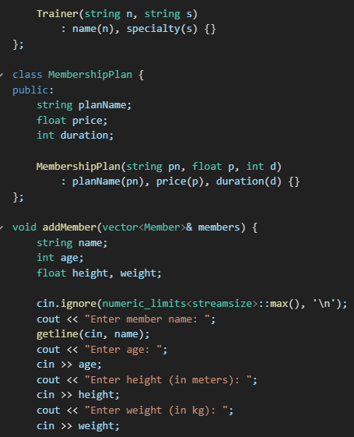

Slide 4
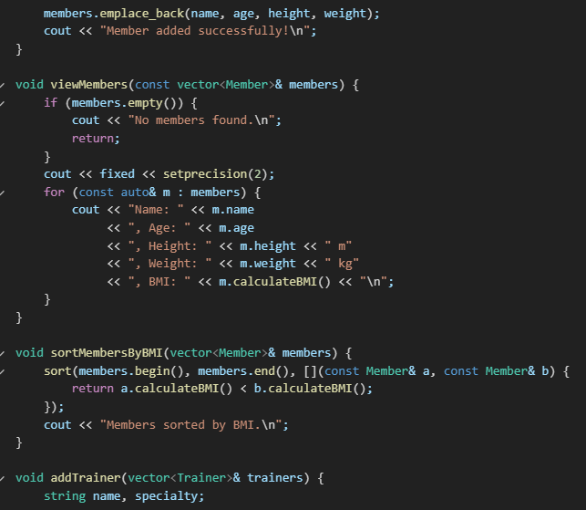

Slide 5
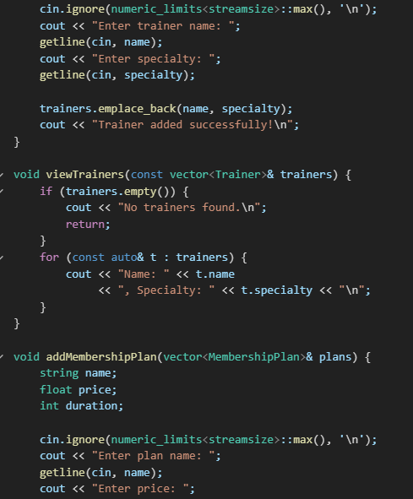

Slide 6
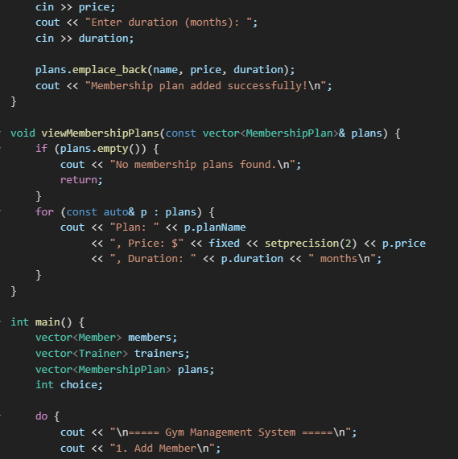

Slide 7
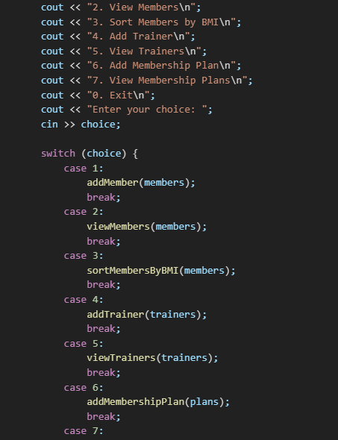

Slide 8
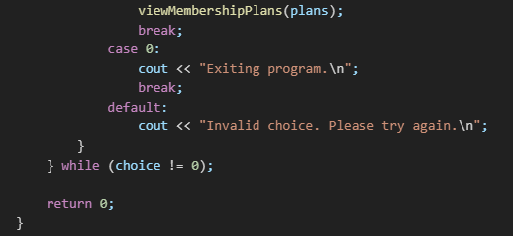

Slide 9
the class digaram of project

Slide 10
Project Summary:
Purpose:
This console-based application manages gym members, including:
Storing their personal data
Calculating BMI (Body Mass Index)
Displaying member details
Structure Overview:
1. Member Class
Handles all data and functions related to a gym member.
Attributes:
name – Member's name
age – Member's age
height – Height (in meters)
weight – Weight (in kilograms)
bmi – Body Mass Index (auto-calculated)

Slide 11
Main Functionality:
Presents a menu-based interface where users can:
Add a new member
View member details
Exit the program
Members are stored in an array of objects (Member members[100]).
Control Flow:
The program runs in a while (true) loop with a switch-case menu:
Adding a member increments the count.
Viewing details loops through all added members and displays them.
Choosing Exit (case 3) ends the program. Error Handling:
Proper validation for menu choice
Ensures BMI is updated immediately after input

Slide 12
Core Operations Implemented
Member Management
Add Member
Inputs: Name, age, height, weight
Operation: Stores a new Member object in a vector<Member>
View Members
Displays all member details including calculated BMI
Sort Members by BMI
Uses std::sort with a custom lambda comparator
Sorts members in ascending order of BMI
Trainer Management
Add Trainer
Inputs: Name, specialty
Operation: Stores a new Trainer object in vector<Trainer>
View Trainers
Displays name and specialty of all trainers

Slide 13
Membership Plan Management
Add Membership Plan
Inputs: Plan name, price, duration
Operation: Stores a new MembershipPlan object in vector<MembershipPlan>
View Membership Plans
Displays all plans with details (price, duration)

Slide 14

Comparative Analysis of Structures and Algorithms
Data Structure: vector
Usage: Used to store members, trainers, and membership plans.
Why it's suitable:
Dynamic resizing – useful for growing gym data
Random access – good for retrieving data quickly
Simple iteration – easy to display or traverse all entries
Alternatives:
list – better for frequent insertions/deletions in the middle
set/map – useful if you want automatic sorting or key-based access (e.g., for searching by name)
Algorithm: BMI Calculation
Formula Used:

Slide 15
Location: Implemented as a method inside the Member class
Why this approach is good:
Keeps BMI logic encapsulated in the class it belongs to
Easy to update or extend (e.g., add BMI classification)
Sorting Algorithm
Implementation: std::sort with a lambda
Why it's effective:
Uses the efficient IntroSort (hybrid of quicksort, heapsort, and insertion sort)
Customizable for any sorting criterion
Alternative:
Manual sort (inefficient and unnecessary when STL is available)

Slide 16
Feature | Current Approach | Suggested Enhancement
Member Lookup | Linear search (via loop) | Use map<string, Member> for fast lookup
Trainer Specialty Search | Not implemented | Add filter or search via find_if()
Duplicate Handling | Not handled | Add checks before emplace_back()
Persistent Storage | Not implemented | Use file I/O or a database for real-world usage

